Slide 1
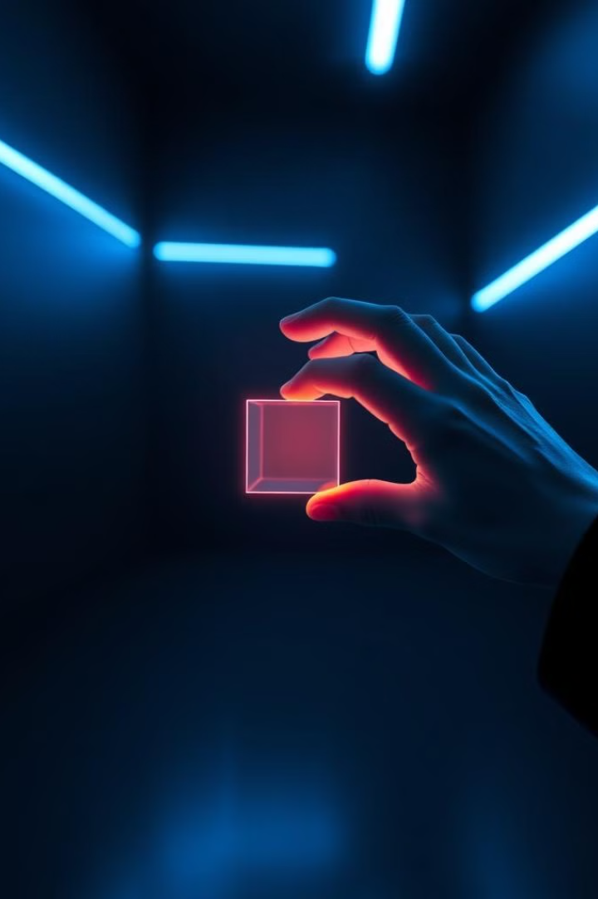
Enhancing Virtual Object Interaction with Hand Gesture Recognition
This presentation explores how hand gesture recognition can revolutionize virtual object interaction, offering a more intuitive and immersive experience. We'll delve into the challenges of traditional input devices and showcase the potential of hand gestures to create a virtual mouse, keyboard, and even painting tools.

Slide 2

Introduction to Virtual Interactions
Direct Manipulation
Indirect Manipulation
This involves users directly interacting with virtual objects, like moving, resizing, or manipulating them using input devices.
Here, users interact with virtual objects through commands or interfaces, relying on software to interpret their inputs and translate them into actions.

Slide 3
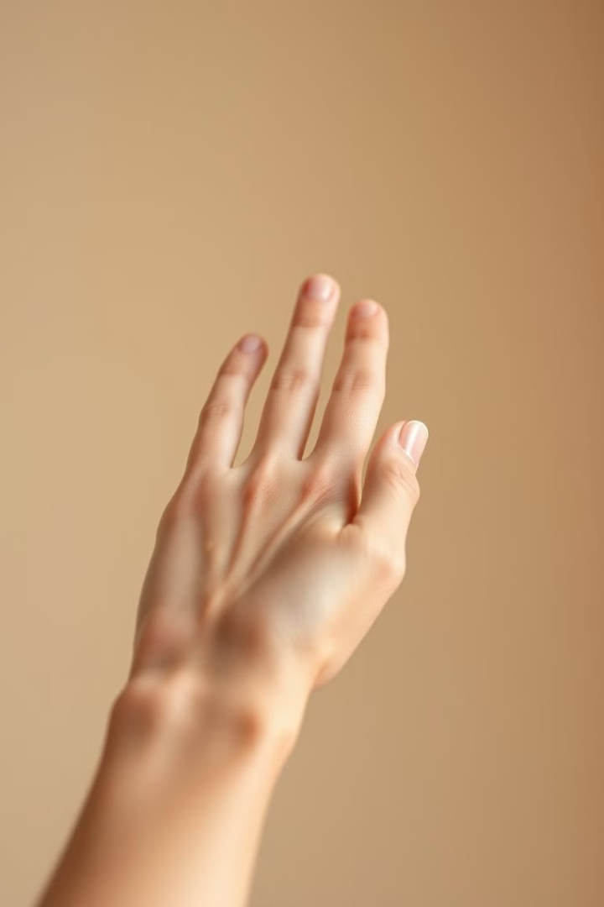
Principles of Hand Gesture Recognition
1
Gesture Detection
2
Feature Extraction
Sensors capture hand movements and translate them into digital data.
Algorithms identify key features of hand gestures from the captured data.
3
Gesture Classification
The extracted features are compared to a database of known gestures for recognition.

Slide 4




Integrating Gesture Recognition into VR Applications
Gesture Library
Defining a set of recognized gestures for specific actions within the VR application.
Gesture Mapping
Linking recognized gestures to corresponding actions or commands within the virtual environment.
Real-Time Processing
Ensuring smooth and responsive interaction by processing gestures in real time.

Slide 5
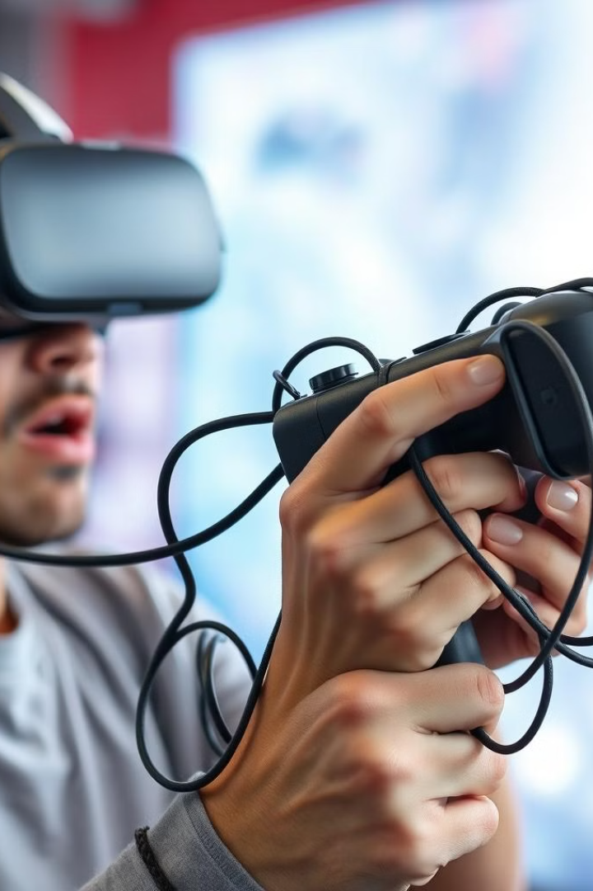
Challenges of Traditional Input Devices
Limited Dexterity
Lack of Immersion
Traditional controllers often restrict natural hand movements, making it difficult to perform fine-grained tasks in virtual environments.
Physical controllers can break immersion, reminding users of the real world and hindering their engagement in virtual experiences.
Learning Curve
Users need to learn complex button combinations and gestures, which can be time-consuming and detract from the overall experience.

Slide 6
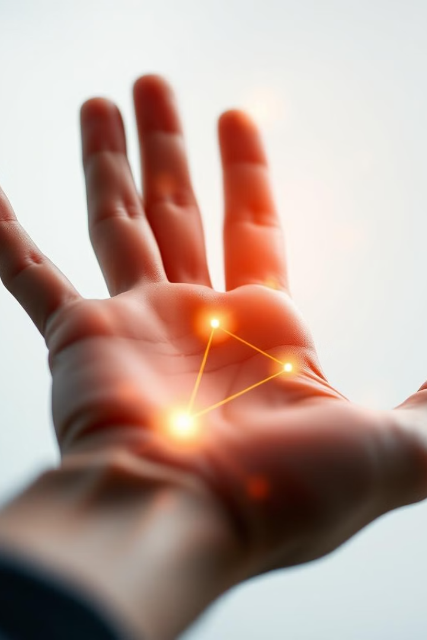
Overview of Hand Gesture Recognition
Camera-Based Tracking
Computer Vision Algorithms
Cameras capture hand movements and analyze their positions, angles, and gestures.
These algorithms process the captured images and extract meaningful data from hand gestures.
Machine Learning Models
Real-Time Processing
The system processes hand gestures in real-time, providing immediate feedback and responsiveness.
Trained models learn to recognize specific gestures and translate them into commands.

Slide 7
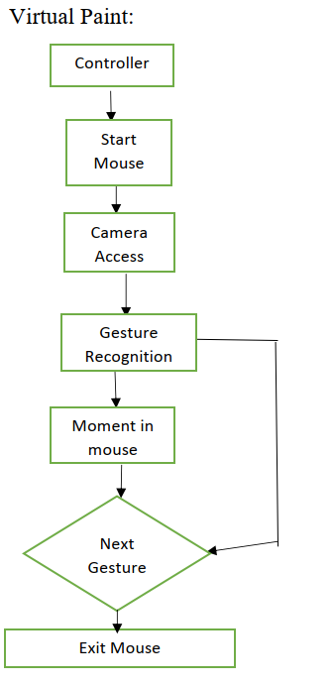
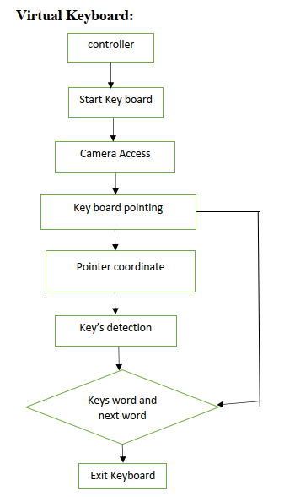
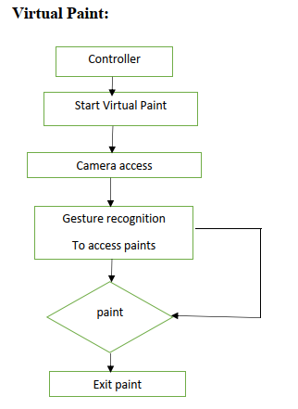
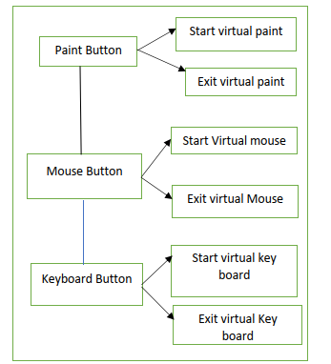
BLOCK DIAGRAM OF CODE

Slide 8
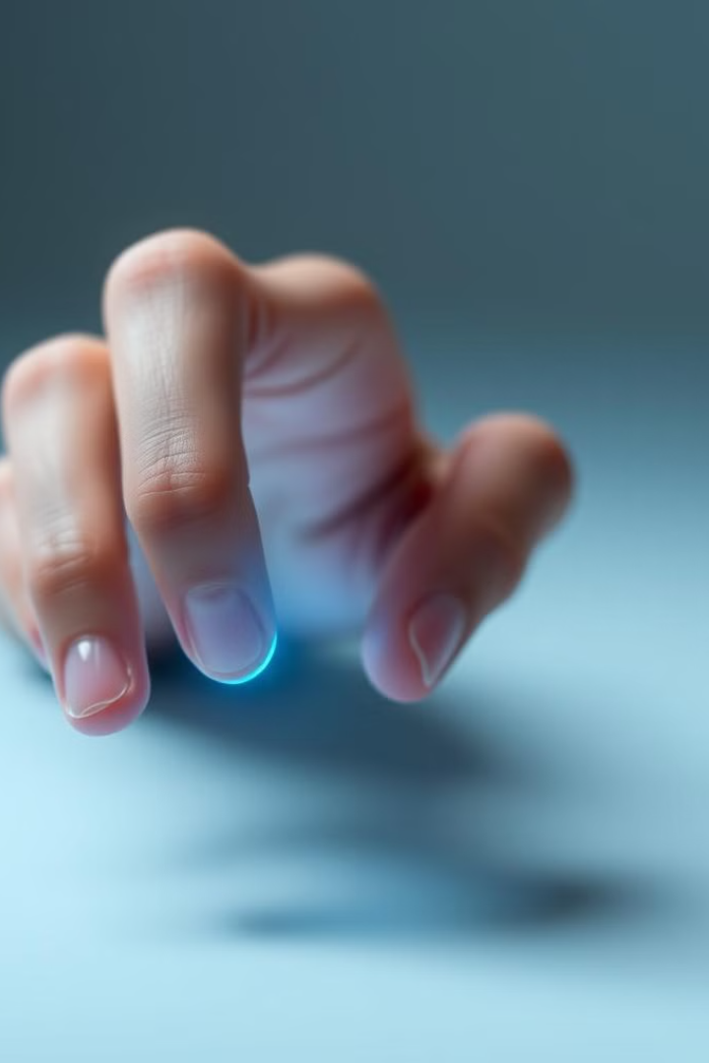
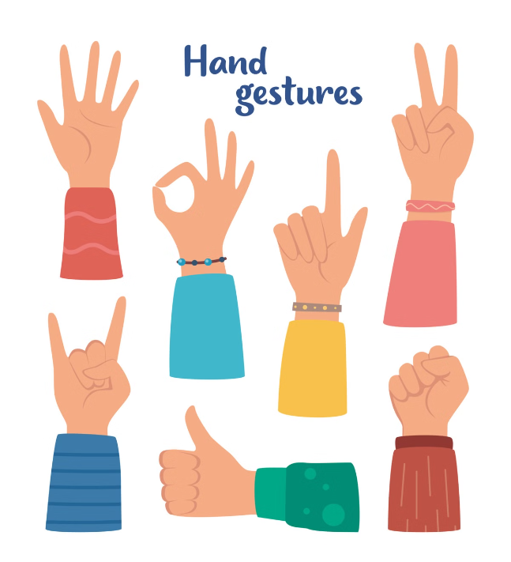




Developing a Virtual Mouse Interface
Hand Tracking
Real-time hand tracking captures user's hand movements and translates them into digital coordinates.
Cursor Mapping
Hand position is mapped to the virtual mouse cursor, enabling precise movement within the virtual environment.
Gesture Recognition
Specific hand gestures are defined to trigger mouse clicks, scrolls, or other actions.
Interactive Feedback
Visual feedback is provided to the user, indicating cursor movement and click actions in real-time.

Slide 9
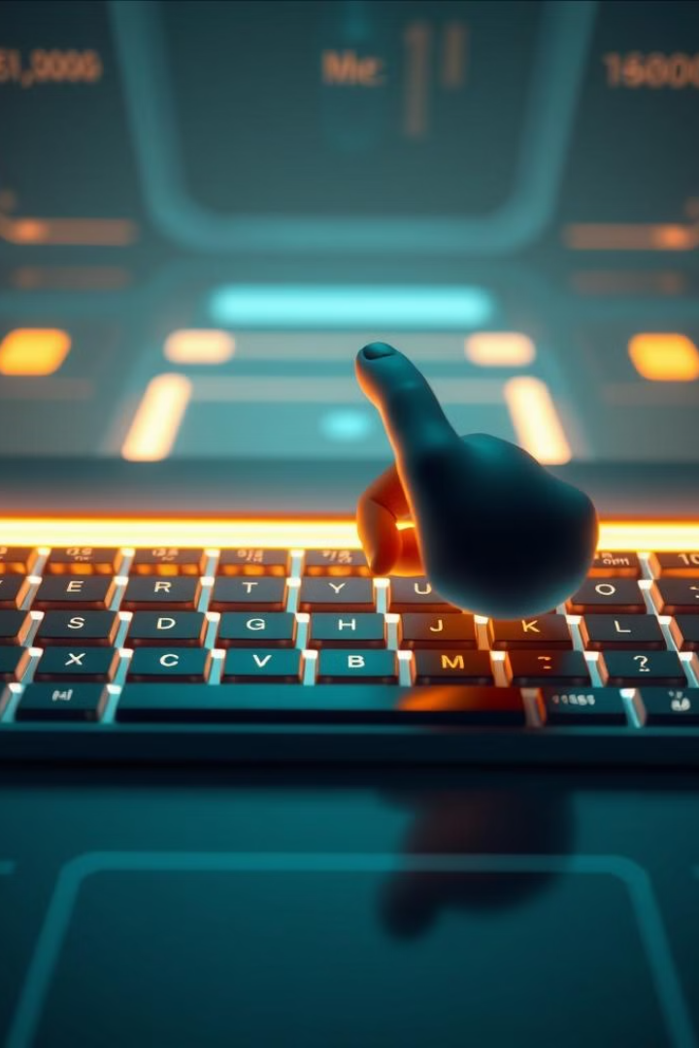
Implementing a Virtual Keyboard
1
Hand Gesture Mapping
Define hand gestures for each keystroke, allowing users to input letters, numbers, and symbols.
2
Gesture Recognition Engine
Utilize machine learning algorithms to identify and translate hand gestures into keyboard characters.
3
Visual Feedback
Display visual feedback to confirm keystrokes, providing clarity and ensuring user confidence.
4
Text Input Integration
Integrate the virtual keyboard with text input fields, allowing users to type in virtual applications and environments.

Slide 10




Enabling Virtual Painting with Hand Gestures
Brush Selection
1
Users can select from a variety of brushes, each with unique characteristics, by making hand gestures.
Stroke Control
2
Hand movements map to brush size, pressure, and direction, allowing users to create intricate details.
Color Palette
3
Hand gestures can be used to access and select colors from a virtual palette, offering a wide range of choices.
Canvas Interaction
4
Users can move the canvas, zoom in or out, and adjust the view to create the desired composition.

Slide 11
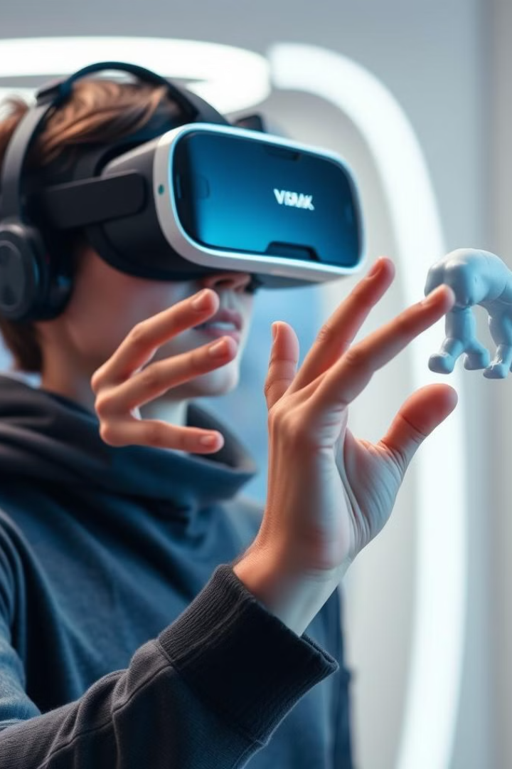
Advantages of Hand Gesture-Based Interactions
Intuitive and Natural
Enhanced Immersion
Hand gestures are an instinctive way to interact with the world, leading to a more natural and intuitive experience.
By eliminating physical controllers, hand gestures promote a deeper sense of presence and engagement in the virtual world.
Increased Dexterity and Precision
Reduced Cognitive Load
Hand gestures are often more intuitive than learning complex button combinations, minimizing cognitive effort and enhancing user experience.
Hand gestures offer finer control over virtual objects, allowing for more precise manipulations and interactions.

Slide 12
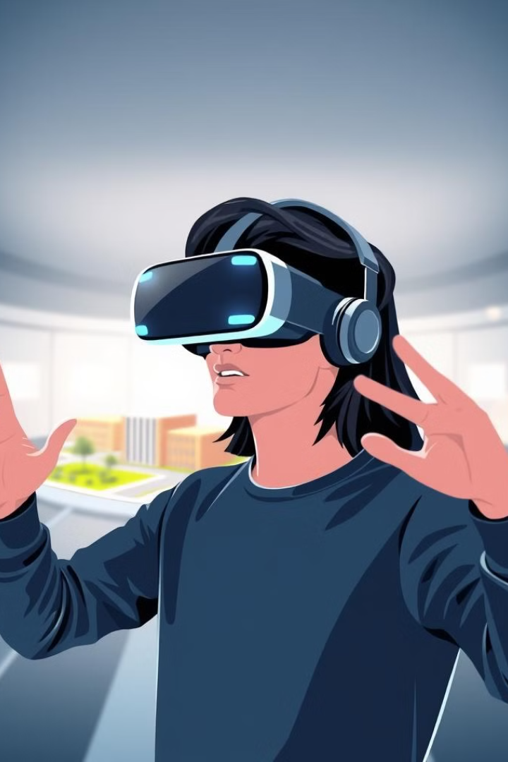
Practical Applications and Use Cases
Virtual Design and Modeling
Virtual Training and Simulation
Hand gestures allow architects, engineers, and designers to manipulate and interact with virtual models in a more intuitive and natural way, accelerating the design process.
Hand gesture recognition can create immersive training simulations for surgeons, pilots, and other professionals, providing a safe and realistic environment for practice.
Interactive Gaming and Entertainment
Accessibility and Inclusivity
Gesture-based controls can enhance gameplay, allowing players to control characters, interact with objects, and experience a more immersive gaming experience.
Hand gesture recognition can provide alternative input methods for individuals with disabilities, improving their access to technology and virtual environments.

Slide 13
Conclusion and Future Directions
Advancements in AI
1
Improving the accuracy and efficiency of hand gesture recognition algorithms.
Haptic Feedback Integration
2
Adding tactile feedback to enhance user experience and realism.
Multimodal Interactions
3
Combining hand gestures with voice commands and eye tracking for richer input.
Mobile and Wearable Integration
4
Exploring gesture-based interactions on mobile devices and smartwatches.

